Slide 1
2025-Apr-23 : kiransonawane1297@gmail.com

Slide 2
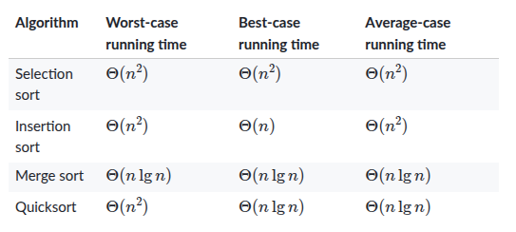
Q1: Coding
What is average case running time of various sorting algorithms like: Selection Sort, Insertion Sort, Merge Sort, Quick Sort

Slide 3
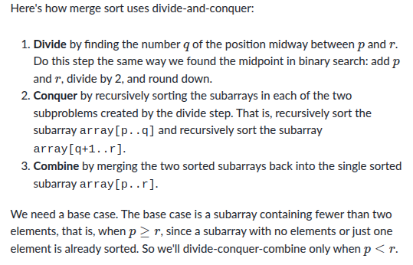
Q2: Discuss “Merge Sort”
OR Write code for Merge Sort

Slide 4
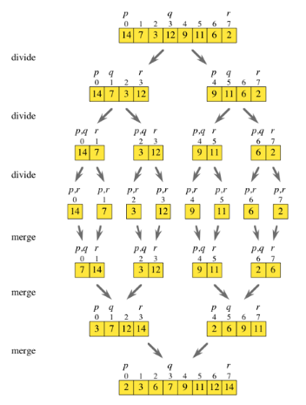
Q3: Solve this Merge Sort problem

Slide 5
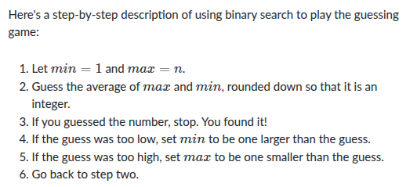
Q4: Discuss “Binary Search”
OR Write code for “Binary Search”

Slide 6
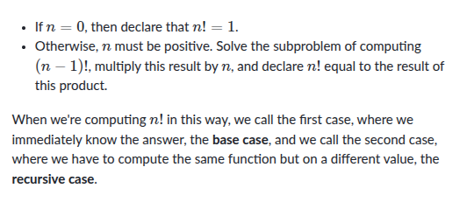
Q5: Write the function for finding Factorial of a number.

Slide 7
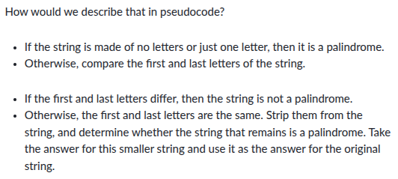
Q6: Can you find out if a String is a palindrome without using “List Indexing”.

Slide 8
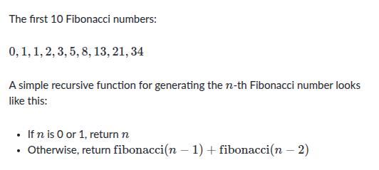
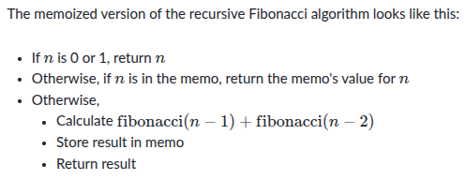
Q7: Can identify any pattern in this series: 0, 1, 1, 2, 3, 5, 8, 13, 21, 34
AND How would you generate these numbers programmatically.

Slide 9
Q1: SQL
Find the student with highest marks.
TABLE: <name, marks>
USING LIMIT CLAUSE:
SELECT name, marks
FROM student
ORDER BY marks DESC
LIMIT 1;
Using MAX() in a subquery:
SELECT name, marks
FROM student
WHERE marks = (SELECT MAX(marks) FROM student);

Slide 10
Q2: Find the student with the second highest marks
Table Schema: <name, marks>
Using LIMIT and OFFSET Clause:
SELECT name, marks
FROM student
ORDER BY marks DESC
OFFSET 1 LIMIT 1;
Using a subquery with DISTINCT and LIMIT
SELECT name, marks
FROM student
WHERE marks = (
SELECT DISTINCT marks
FROM student
ORDER BY marks DESC
OFFSET 1 LIMIT 1
);

Slide 11
Q3: Reporting
Table: <name, section, marks, result(pass/fail)>
Create a tabular report with the below schema:
<section, pass_count, fail_count>
SELECT
section,
COUNT(CASE WHEN result = 'pass' THEN 1 END) AS pass_count,
COUNT(CASE WHEN result = 'fail' THEN 1 END) AS fail_count
FROM
student
GROUP BY
section;

Slide 12
Q4: Deleting Duplicates
TABLE SCHEMA: <id, name, marks>
How would deduplicate the data in this table if you only want to keep Keep only one row for each combination of name and marks.

Slide 13
Q5: Write a query to get the department with the highest number of employees.
SELECT department, COUNT(*) AS employee_count
FROM employees
GROUP BY department
ORDER BY employee_count DESC
LIMIT 1;

Slide 14
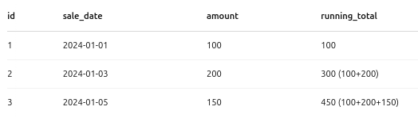
Q6: How would you calculate a running total in SQL?
SELECT
id,
sale_date,
amount,
SUM(amount) OVER (ORDER BY sale_date) AS running_total
FROM sales;

Slide 15
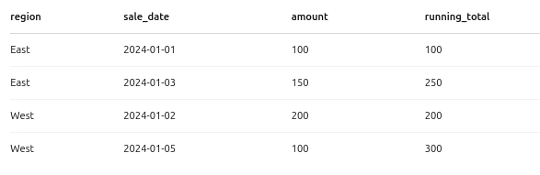
Q7: Compute a running total per region
SELECT
region,
sale_date,
amount,
SUM(amount) OVER (
PARTITION BY region
ORDER BY sale_date
) AS running_total
FROM sales;

Slide 16
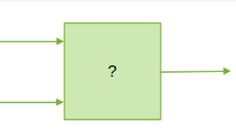
Q1: Machine Learning
In this model, you have place “Data”, “Rules” and “Results” on the arrows.
Where would you keep which if the model represents “Coding” and where would you keep which if the model represents “Machine Learning”.

Slide 17
Q2: Linear Regression
X = -1, 0, 1, 2, 3, 4
Y = -3, -1, 1, 3, 5, 7
What kind of model would you use for this data for best results?
Q4: Why and how would I able to use Neural Network for this data from Q3?

Slide 18
Q3: Neural Network
What would be the output of this code?
Assuming all the imports are there.
model = keras.Sequential([keras.layers.Dense (units=1, input_shape=[1])])
model.compile(optimizer='sgd', loss='mean_squared_error')
xs = np.array([-1.0, 0.0, 1.0, 2.0, 3.0, 4.0], dtype=float)
ys = np.array([-3.0, -1.0, 1.0, 3.0, 5.0, 7.0], dtype=float)
model.fit(xs, ys, epochs=500)
print(model.predict([10.0]))

